Slide 1
Research Portal Management System
Streamlining Research Publication Management
Submitted By
NABAJIT PAUL – CSB22034

Slide 2
Presentation Outline
Introduction
Problem Statement & Significance
Objectives & Scopes
System Requirements & Software
System Overview
System Design
Technology Stack
Future Work And Enhancements
Conclusion
References

Slide 3
Introduction -
This presentation discusses the development of a web-based application designed to manage research publications efficiently. The tool integrates seamlessly with ORCID for automatic data syncing , data fetching and aims to address common challenges faced by researchers in academic institutions.
Researchers, particularly students and faculty in academic settings, often struggle with efficiently managing and showcasing their diverse research outputs. This includes keeping track of publications listed on ORCID

Slide 4
Problem Statement -
It's hard to manage different types of research work.
Keeping track and updating things by hand takes a lot of time and effort.
There's no single system to see and manage everything in one place
Problem Significance -
Improves Data Accuracy . Supports Researchers , Faculty Members. Saves Time And Effort .

Slide 5
Objectives -
To design and develop a web application for user registration and authentication, incorporating ORCID ID.
To implement functionality to fetch and store public research works from a user's ORCID profile using the ORCID API.
To enable users to upload their research papers along with relevant metadata.
To create a user-specific dashboard displaying both ORCID-linked and manually uploaded publications.

Slide 6
Scope -
User registration (student/faculty) with ORCID ID.
Secure user login.
Fetching and displaying public works from ORCID.
Manual uploading of research papers with metadata.
User dashboard to view own ORCID works and uploaded papers.
Admin user with an overview dashboard (total users, all papers).

Slide 7
System Requirements & Specifications
Functional Requirements -
User Registration & Authentication Module
ORCID Integration Module
Paper Management Module
User Dashboard Module
Admin Dashboard Module
Non-Functional Requirements --
Performance
Security
Usability

Slide 8
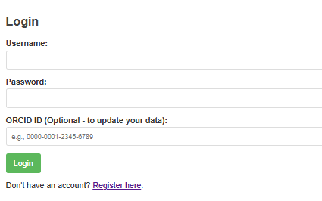
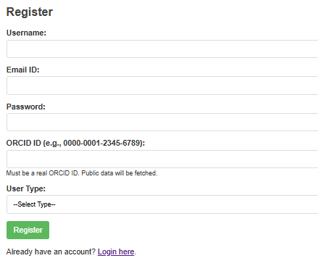
System Overview -
Login Dashboard -
Register Dashboard -

Slide 9
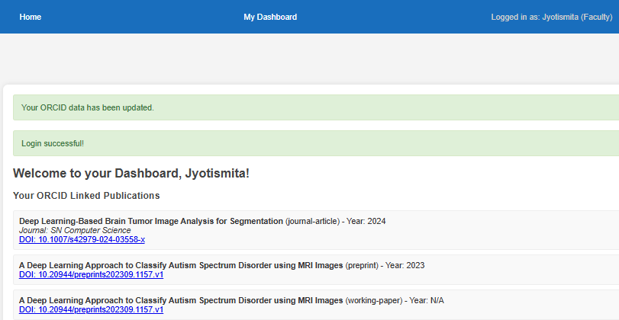
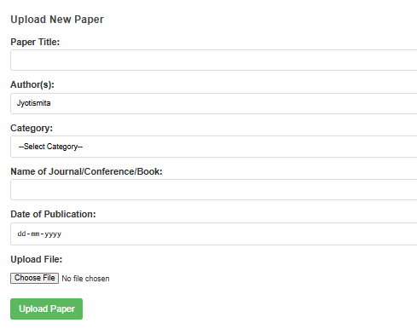
System Overview-
User Dashboard -
Upload Paper Dashboard -

Slide 10
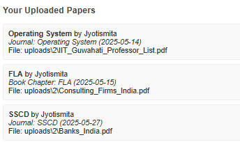
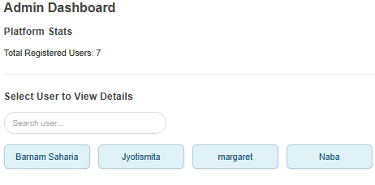
System Overview -
Uploaded Paper Dashboard -
Admin Dashboard -

Slide 11
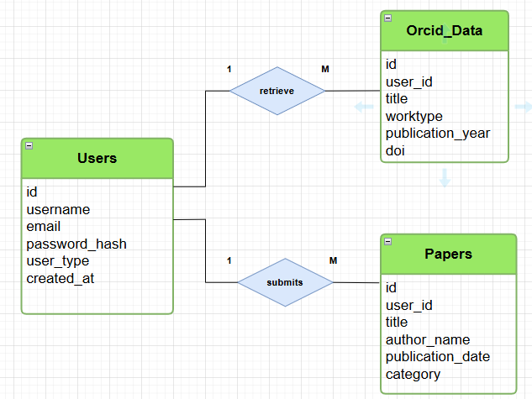
System Design-
E-R Diagram -
Users → Papers ➤ A single user can submit multiple papers, but each paper is submitted by only one user. ➤ Relationship :- One-to-Many ( 1 : M )
Users → Orcid_Data ➤ A single user can retrieve multiple ORCID records, but each ORCID record is tied to only one user. ➤ Relationship :- One-to-Many ( 1: M )

Slide 12
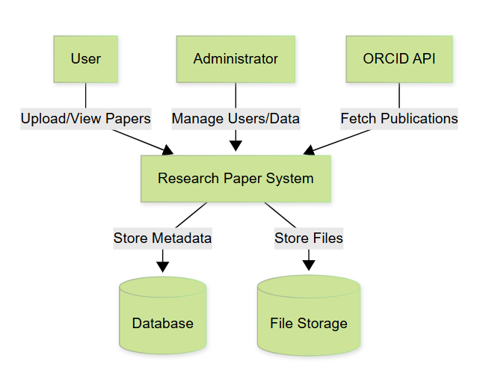
System Overview-
DFD Diagram -
Level 0 -

Slide 13
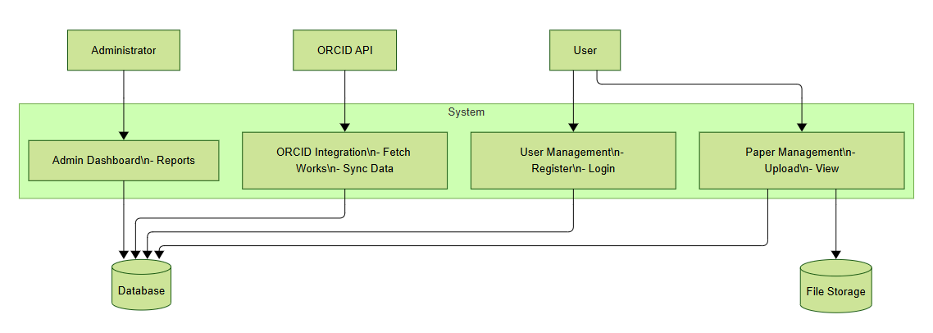
System Overview-
DFD Diagram -
Level 1-

Slide 14
Technology Stack -
FRONT-END | BACK-END | ENVIRONMENT
HTML | PYTHON | VS CODE ( IDE )
CSS | FLASK ( FRAMEWORK ) | WERKZEUG DEVELOPMENT SERVER (WEB SERVER) (DEFAULT SERVER USED BY FLASK)
JAVASCRIPT | MYSQL

Slide 15
Future Work and Enhancements -
Enhanced Admin Capabilities -
User management (edit/delete users, reset passwords).
Ability to edit/delete any uploaded paper.
File Preview and Download Management -
Securely serve uploaded files for download.
Email Notifications -
Notifications for new user registration (to admin)
Successful paper upload (to user).

Slide 16
Conclusion -
The Research Project Management System effectively addresses the common challenges faced by researchers in managing their outputs. The integration with ORCID significantly enhances the visibility and accuracy of research records, paving the way for future enhancements and use in broader institutional contexts.

Slide 17
References -
Flask Documentation: https://flask.palletsprojects.com/
SQLAlchemy Documentation: https://www.sqlalchemy.org/
ORCID Public API Documentation: https://info.orcid.org/documentation/apitutorials/api-tutorial- read-data-ona-record/ (or the specific v3.0 docs)
Requests Library Documentation: https://requests.readthedocs.io/
Jinja2 Documentation: https://jinja.palletsprojects.com/
MySQL Documentation: https://dev.mysql.com/doc/

Slide 18
Thank you!

